Slide 1
Loan Credit Defaulter Analysis EDA Case Study:
- By
Saloni Meshram

Slide 2
Problem Statement :
We have a dataset from the largest online loan marketplace facilitating personal loans. The company wants to understand the driving factors (or driver variables) behind loan default, i.e. the variables which are strong indicators of default..
This is achieved by EDA (Exploratory Data Analysis) on bank data, wherein we analyse the pattern present in data and help bank in mitigating two types of risks associated with loan approvals:
If the applicant is likely to repay the loan, then not approving the loan results in a loss of business to the company.
If the applicant is not likely to repay the loan, i.e he/she is likely to default, then approving the loan may lead to a financial loss to the company.
Credit loss is the amount of money lost by the lender when the borrower refuses to pay or absconds with the money owed. In other words, borrowers who default cause the biggest losses to lenders. In this case, customers labelled as ‘charged-off’ are the ‘defaulters’.
The aim of this EDA Case study is to identify patterns indicating that a person is likely to default and to identify these risky loan applicants so that such loans can be reduced, thereby cutting down the amount of credit loss.

Slide 3
Dataset Overview :
The data is collected from a company which is the largest online loan marketplace facilitating personal loans, business loans, and the financing of medical procedures.
The dataset contains information about past loan applicants and whether they ‘defaulted’.
It contains the complete loan data for all loans issued from 2007 to 2011.
There are 39717 rows and 111 columns in total.
The analysis is mainly done on the information like loan amount, term length, interest rate, annual income, installment, employee title, employee length, issue date, purpose, total payment, total received interest and the target variable “Loan Status”.

Slide 4
Data Cleaning :
The data set is cleaned by following the below steps:
Dropping unwanted columns with more than 80% missing values.
Missing values were imputed or replaced in some columns. Another way to deal with is to drop them completely.
The outliers were present in columns like annual income, interest rate and loan amount which couldn’t be ignored. So, outliers were kept as it is.
The data type of column like interest rate is changed to integer type to facilitate the numerical comparison.

Slide 5
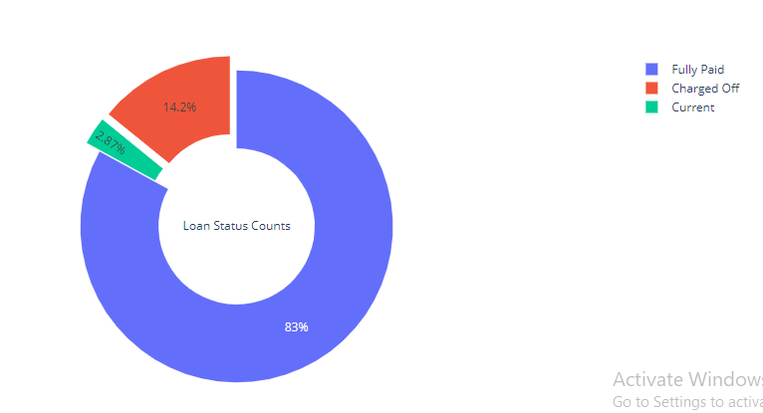
Univariate Analysis :
Percentage of Defaulters :
83% people have repaid their loan instalments on time.
2.87% people are currently paying loans which means they have ongoing instalments.
About 14% of loans are Charged off which is a big loss to the company.
We'll analyze the ways to reduce this loss in following analysis.

Slide 6
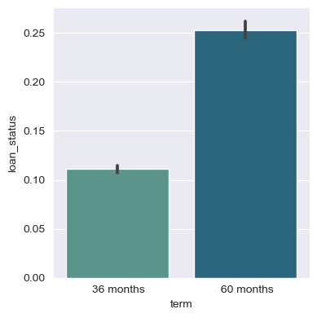
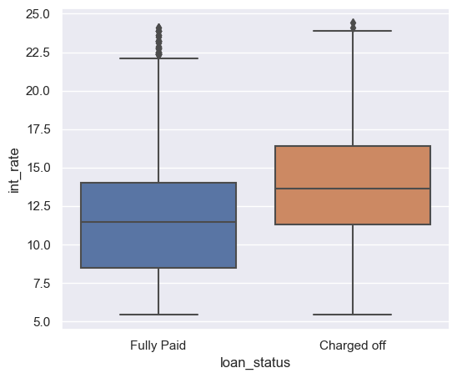
Interest rate over loan statu:
The median interest rate on fully paid loans is about 11%.
The median interest rate on charged off loans is about 14%.
Overall, the charged off loans have higher rate of interest.
Loan term length:
More than 70% of loans are having a term of 36 months and nearly 26% have 60 months term plan.

Slide 7
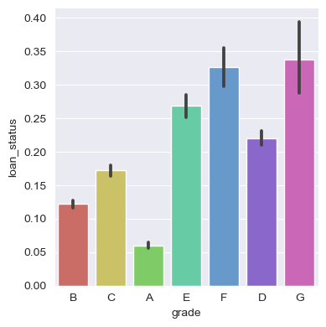
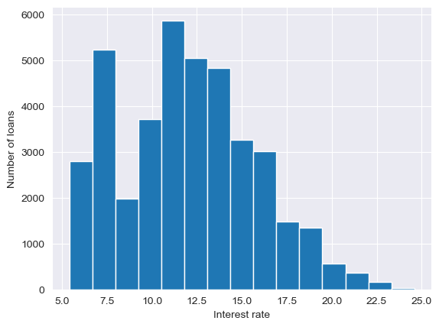
Loan status over Grades:
Clearly, as the grade of loan goes from A to G, the default rate increases. This is expected because the grade is decided by Lending Club based on the riskiness of the loan.
Number of loans over interest rate:
Maximum loans of interest of between 11 to 12%. Also, similar range is present for 7.5% interest.
Max interest rate charged by bank is 24.59% per year which may affect the payment of loan on time. More the interest rate, less likely is the loan to be repaid.

Slide 8
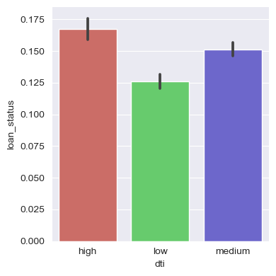
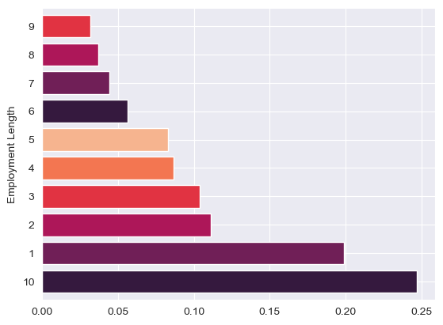
Dti Vs Loan_status:
Obviously the high dti ratio will lead to more defaults.
Employment length:
About 25% of the people taking loan have a employment length of more than 10 years. And lending money to these people is safer as there are high chances of repayment.
About 19% people have employment experience of a year or less.

Slide 9
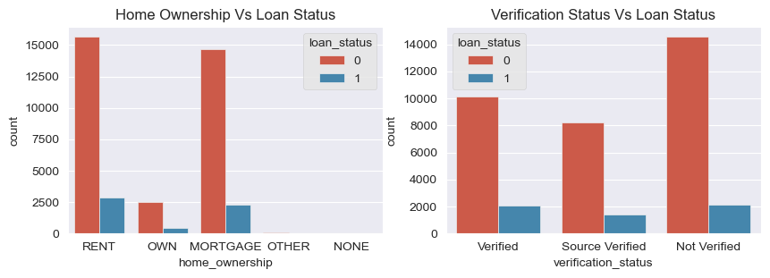
Home Ownership Vs Loan Status :
38% people have mortgage type home_ownership meaning they took a home loan. Maximum of which have repaid their loan.
Least count of people having their loans charged off are having their own home.
Verification of Annual income Vs Loan status :
People whose annual income was verified have the lowest count of charged off loans.

Slide 10
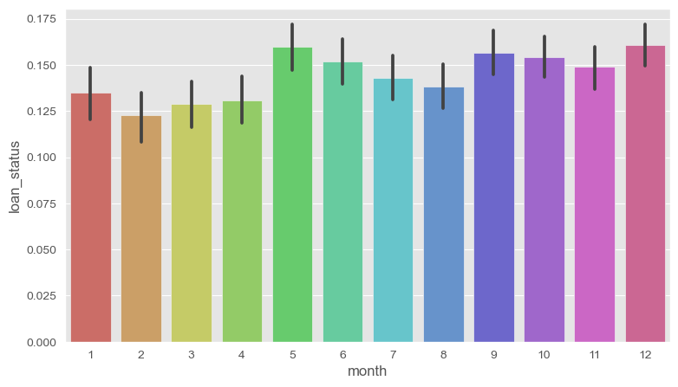
Loan Status over months in several years:
The default rate is comparatively more in May, June, September, October, December.

Slide 11
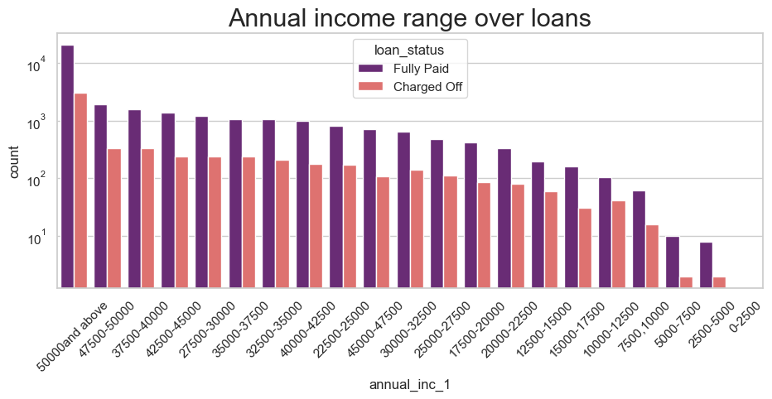
Annual income range over Loans :
Most of the loans which are fully paid have average annual income of 70000.
Income range from 50000 and above is having more number of loans that are fully paid, same as for charged off loans.
Very less count for income range 5000 and below. And the charged off loans are also negligible for this range.

Slide 12
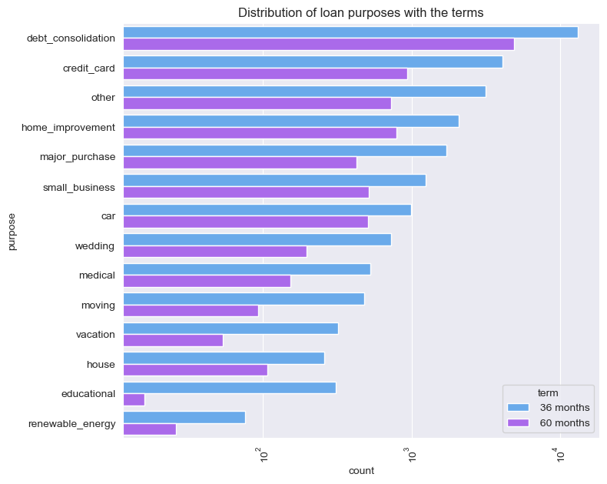
Loan Status over different loan purposes :
Most repaid loans came from purpose 'debt_consolidation' means max people are taking loans for paying other loans.
Most charged off loans are also of 'debt_consolidation' purpose followed by 'small business' and 'credit card' purpose category.
Its the safest for banks to give loan to renewable_energy type purpose.

Slide 13
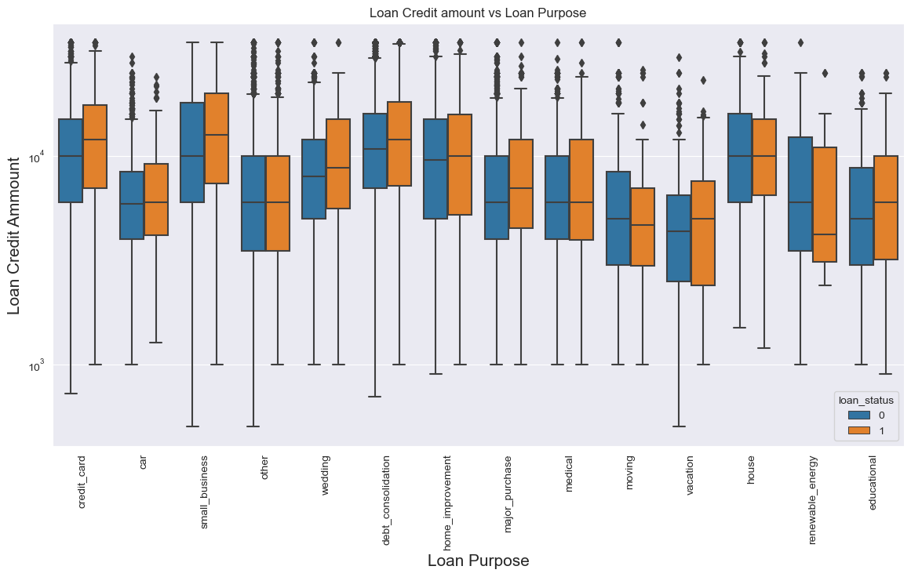
Loan_ammount Vs Purpose Vs Loan_status: 1. The credit amount of Loan purposes like 'Buying a house' or 'Home improvement', 'Credit card' and 'Small business' is higher with maximum defaulter rate. 2. Money for 'Car loan' , 'Vacation' and 'Education' is having less credits applied for. 3. The default rate is also very less for these purposes.

Slide 14
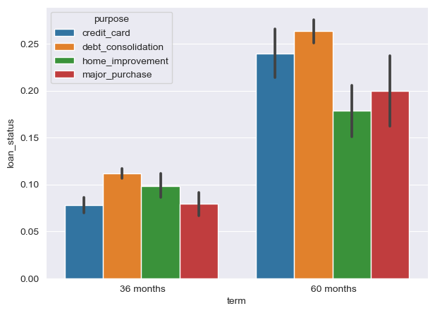
Segmented Analysis:
Mostly the loans for debt-consolidation with 60 months term length are having maximum defaluter rate.
Credit card loans with 60 months term length are also at high risk of getting charged off.
Overall, maximum defaulte rate lie in 60 months term length.

Slide 15
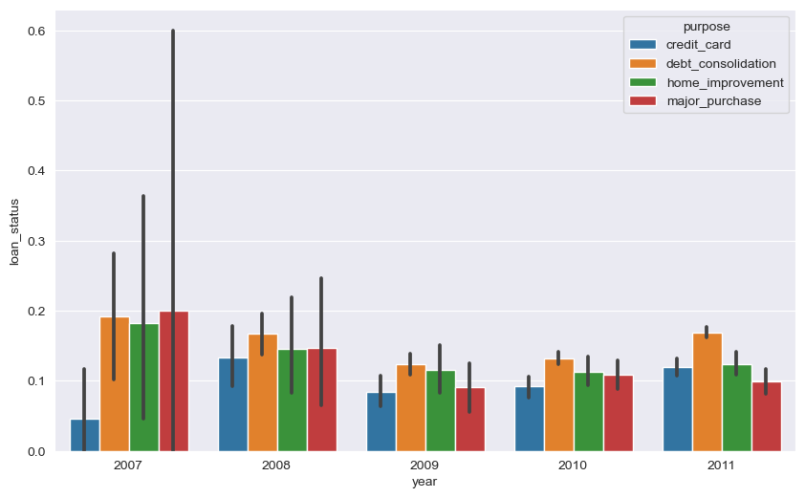
Loan_status over years for various purposes:
There is no much difference in loan pattern from 2008 to 2011.
While in year 2007, most of the defaults are caused with major_purchase showing the maximum defalut rate.
Throughout all these years, debt-consolidation remains the main purpose causing defaluts.

Slide 16
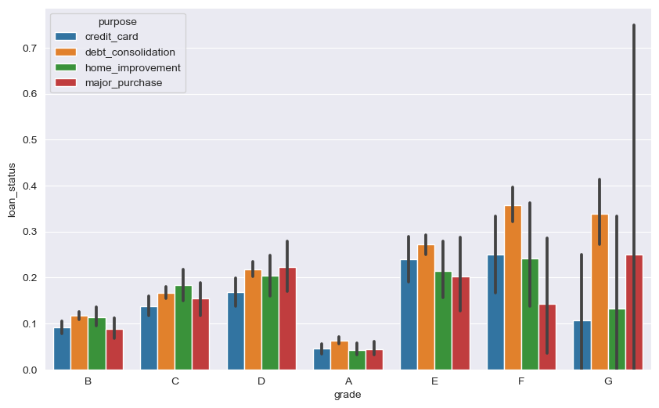
Loan Status over grades and Purposes:
Clearly most of the defaulter loans are in E, F and G grade where debt-consolidation is sowing the highest peak.
The defaulter rate is increasing from A to G as we have already seen before.

Slide 17
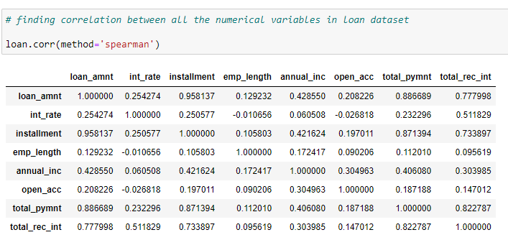
Multivariate Analysis :
Numerical-Numerical type analysis of loan dataset:
The corr() method calculates the relationship between each column in the data set.
Columns with correlation coefficient close to 1.0 have maximum correlation indicating direct proportionality.
While those with correlation coefficient closer to 0.0 or –ve , are inversely proportional to each other.

Slide 18
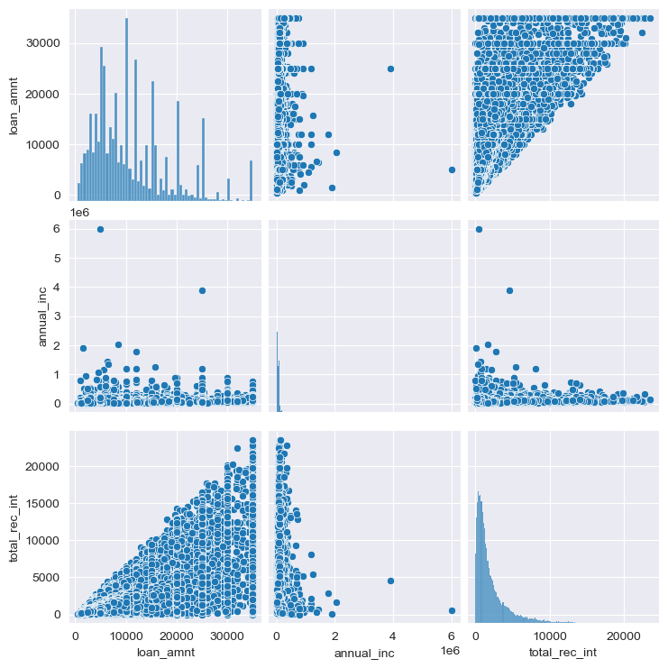
A pairplot showing correlation between loan amount, annual income and total received interest:

Slide 19
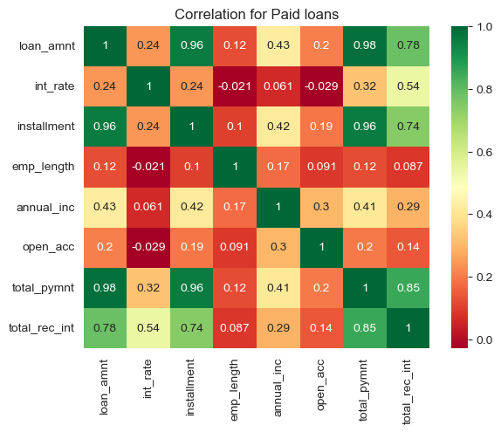
Correlation between various factors for Paid loans :
Loan ammount and Installments have max correlation and are directly proportional.
Installments are inversely proportional to the interest rate. More the interest, lesser the mmount of installments.
People who have max interest on the loan ammount have leat number of accounts open and also less length of employment.
Total ammount repaid is inversely proportional to the employment length.

Slide 20
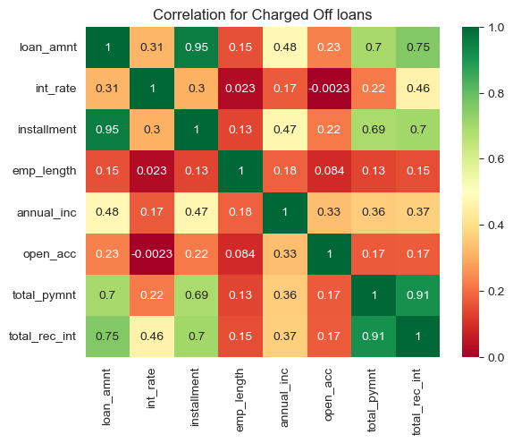
Correlation between various factors for Charged Off loans :
Total repayments recieved are having maximum installment ammounts as well as maximum recieved interest.
People who have max interest on the loan ammount have leat number of accounts open and also less length of employment.
Employment length is directly proportional to the installment ammount.

Slide 21
Insights :
Bank should focus more on older people having more length of employment than those having lesser employment years to ensure repayments.
2. Bank should check many times while providing loans to purposes like 'Buying a house', 'Credit card' and 'debt_consolidation' as these types have highest default rate.
3. The annual incomes should be verfied to avoid any risk.
4. Mortgage loans are a good option for increasing business which is the safest option for banks to reduce unsuccessful payments.
5. Families with less income should be focused to increase business.
6. Also loans with more interest are at high risk of getting charged off. So, bank should not exceed the interest rate more than 15% on higher credits as they might not br repayed fully. Instead the interest rate should be in range of 7% to 12% max.
7. Also with loan purpose ‘Small Business’ and 'Credit Card' is having higher number of unsuccessful payments on time, so avoiding these purposes is a good option.
8. Get as much as clients from housing type ‘With parents’ as they are having least number of unsuccessful payments.

